Slide 1
MLOps research
Khanin Sisaengsuwanchai,
MS in Analytics, University of Southern California

Slide 2
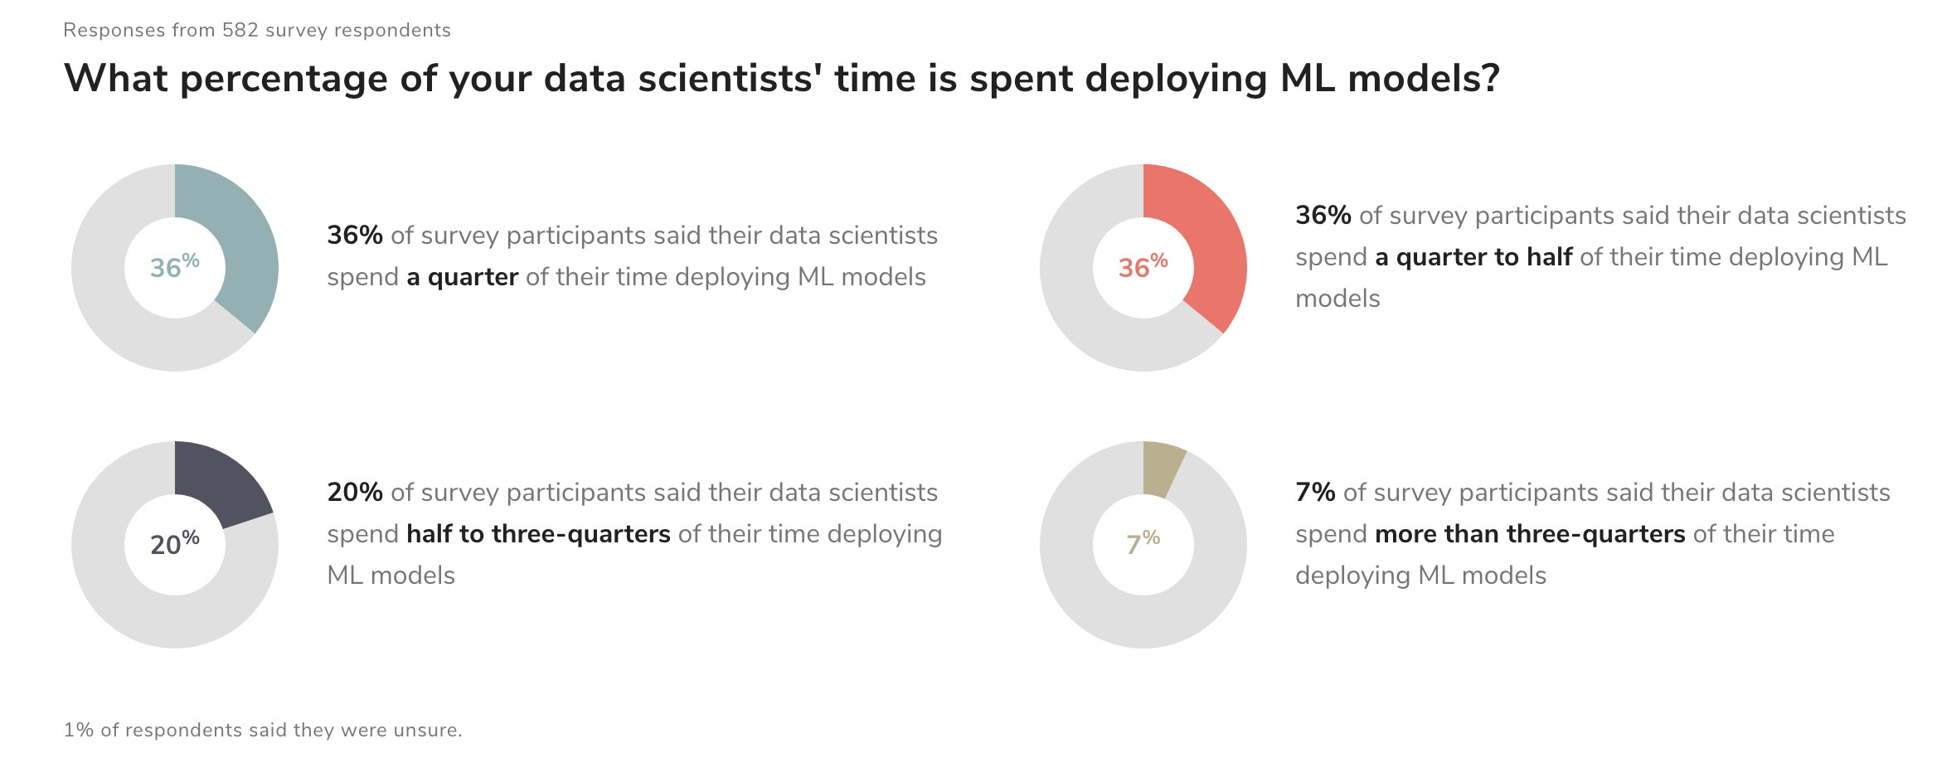
Motivation for MLOps
Solving production deployment problems e.g. non-consistent deployment approach, support only batch processing, and server maintanance
Developing ML solutions on Jupyter notebook is completely different than deploying ML into production environment.
Source: https://ml-ops.org/content/motivation

Slide 3
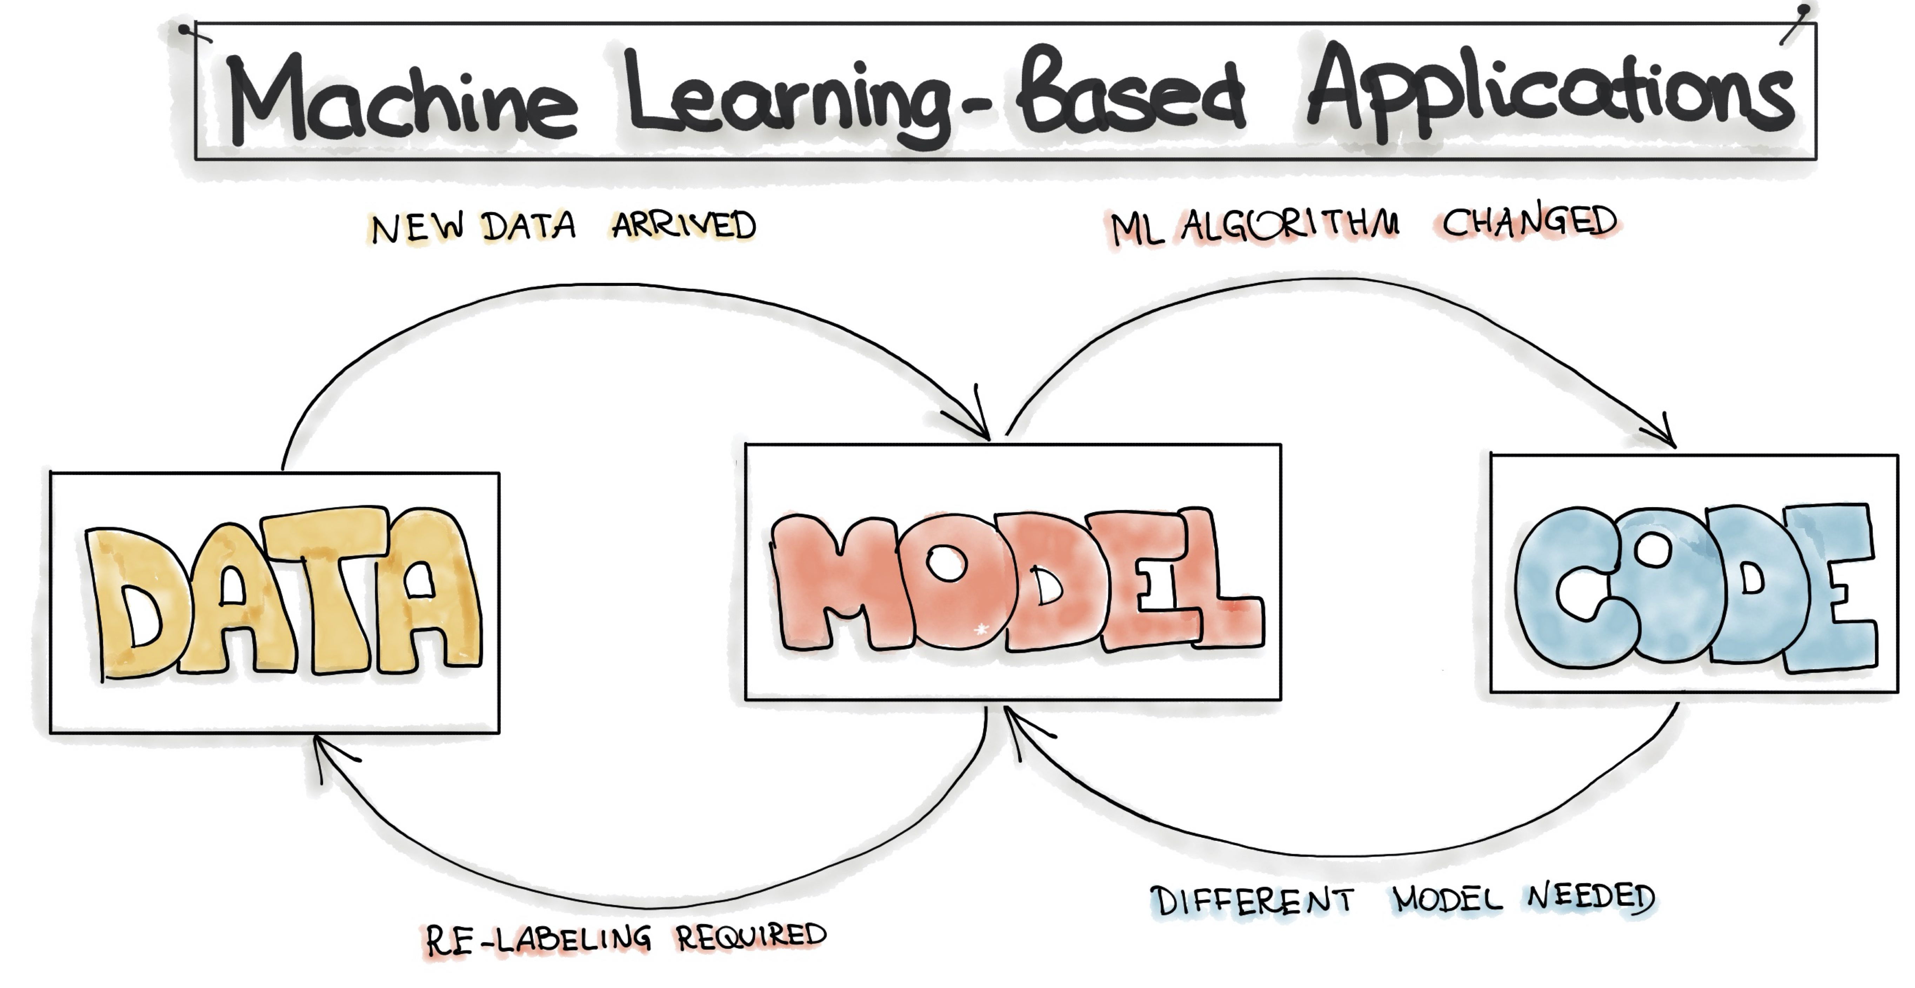
Motivation for MLOps (cont’): what could be changed in ML-based applications?
Other common issues
- Locality: When transferring existing ML models to other business that has different behaviors or demographics.
Source: https://ml-ops.org/content/motivation

Slide 4
What is MLOps?
The term MLOps is defined as “the extension of the DevOps methodology to include Machine Learning and Data Science assets as first-class citizens within the DevOps ecology” Source: MLOps SIG.
Machine Learning Operationalization Management (MLOps) provides an end-to-end machine learning development process to design, build, and manage reproducible, testable, and evolvable ML pipelines.
Compatible with agile principles through CI/CD that falls under DevOps
Data Scientists, ML engineers, and AI leader companies are increasingly adopting the MLOps approach instead of batch processing to release ML-powered software.
Reference:
https://ml-ops.org/
https://azure.microsoft.com/en-us/services/machine-learning/mlops/#features

Slide 5
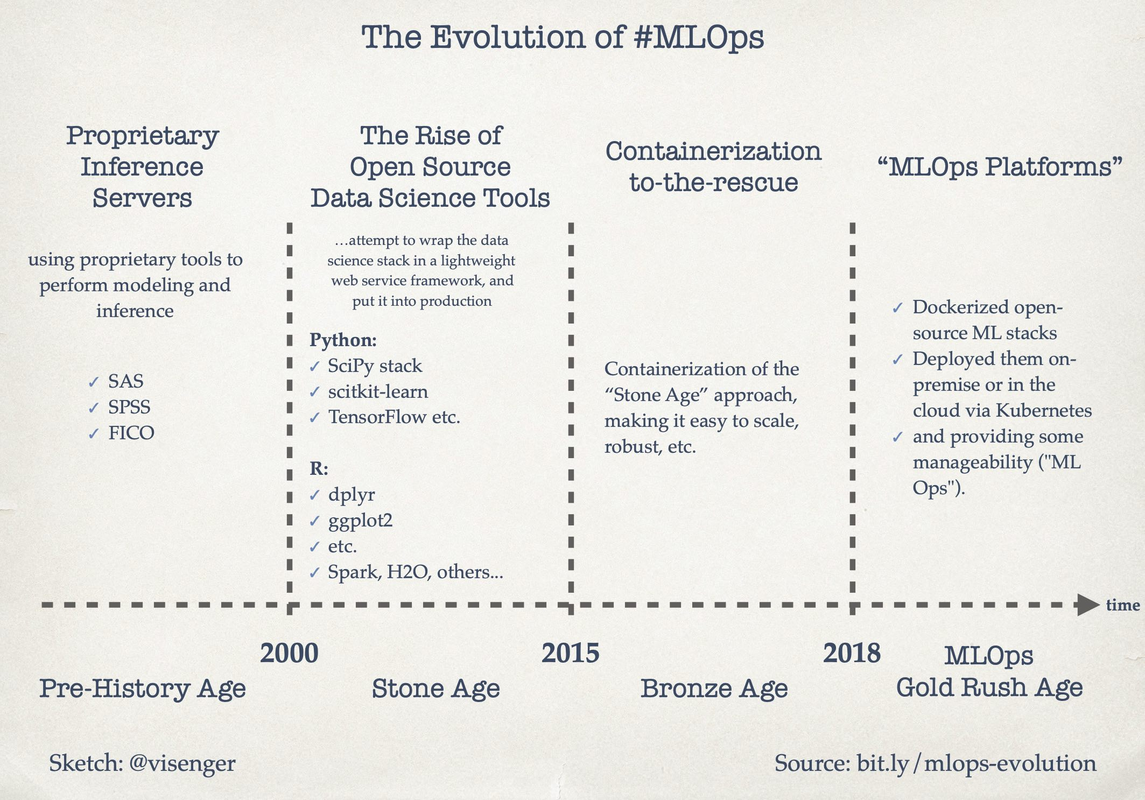
Source: https://ml-ops.org/content/motivation

Slide 6
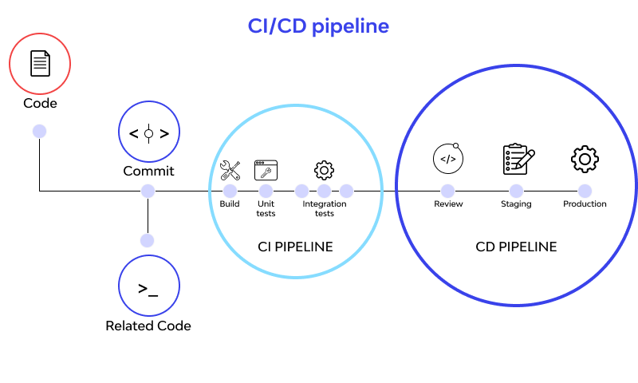
What is Continuous integration/ Continuous Deployment (CI/CD)?
CI/CD is a part of DevOps and MLOps where it combines continuous integration and continuous delivery practices.
Using a CI/CD pipeline, changes such as build, test, and deploy made by developers are tested and push outed automatically for deployment.
CI/CD thus minimizes downtime, accelerates frequent iterations, and minimizes errors through version control.
Reference: https://www.wallarm.com/what/what-is-ci-cd-concept-how-can-it-work, and https://about.gitlab.com/topics/ci-cd/

Slide 7
MLOps VS DevOps
MLOps
Designed to support the flow of training, serving, rollout and monitoring.
Use both data, code, and trained ML model
ML workflow
Preprocess input data
Analyze, and run experiments with data
Implement ML models, and measure performance
Pickled/serealized models
Turn into REST API services
Monitor performance metrics
Retrained when the accuracy belows acceptable threshold
DevOps
Designed for programming tasks
Use mainly code
Programming workflow
Write code
Tests run automatically
Review and merge
New version builds
Built executable deployed to environment
Further tests
Promote to production environment
Monitor - stacktraces or error codes
Source: https://hackernoon.com/why-is-devops-for-machine-learning-so-different-384z32f1

Slide 8
Azure MLOps architecture
https://www.youtube.com/watch?v=nst3UAGpiBA
https://github.com/microsoft/MLOps

Slide 9
Getting started with Azure MLOps
https://github.com/microsoft/MLOpsPython/blob/master/docs/getting_started.md

